Slide 1

Permission to be Human
12 @ 12

Slide 2
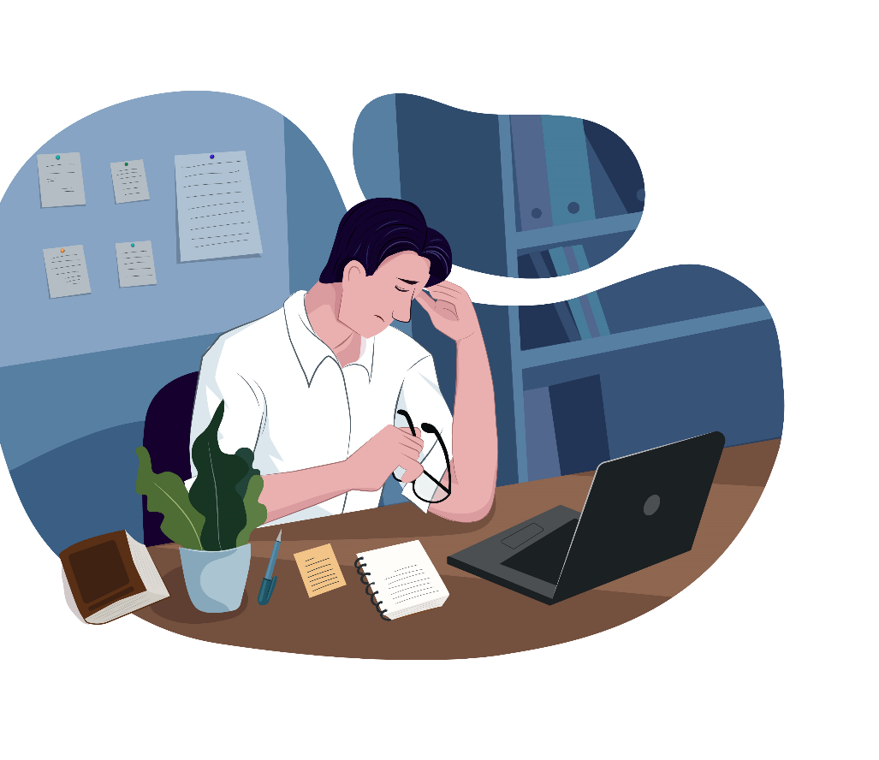
It’s easy to think that wellbeing and happiness means being happy all the time.
That experiencing painful emotions indicates something is wrong with us
But we need to give ourselves permission to be human.
Tal Ben Shahar

Slide 3

When we’re comfortable with the who range of our emotions – the negative as well as the positive ones –
Better learners
More successful
Deepest sense of wellbeing
Robert Biswas-Diener

Slide 4

Emotional Agility
Difficult emotions are part of who we are - and our most difficult ones are signposts to the things that we value the most

Slide 5

Between stimulus and response there is a space.
In that space is our power to choose our response.
In our response lies our growth and our freedom.
Viktor Frankl

Slide 6
Emotional Agility
Show up
See as data and not directives.
Step Out
Create distance between you and your emotions by labelling them as accurately as possible. Instead of saying “I am …” Try saying “I am noticing that I am feeling …”.
Choose
Choose your response based on your values. What matters most to you in this situation? What might be a helpful way to respond?
What information are they giving you?

Slide 7

It can be helpful to know that
Studies suggest most of us are wired for resilience
We can not only withstand but get through better in some way

Slide 8
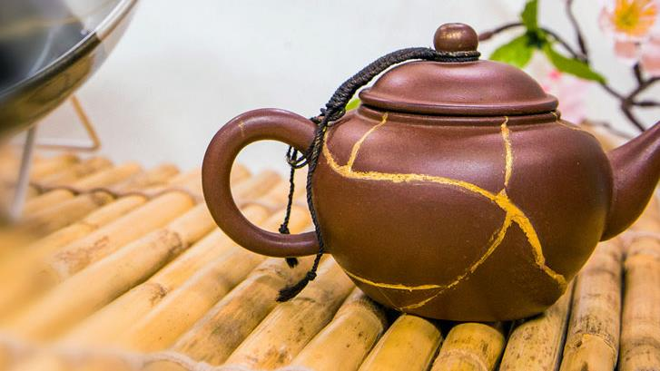
The Art of Precious Scars
Kintsugi

Slide 9

Want to find out more?
George Bonanno
Remarkable Resiliency
Robert Biswas-Diener
The upside of your dark side
Susan David
Emotional Agility

